Slide 1

Year 6 SATs 2026 Presentation for Parents, Carers & Guardians

Slide 2
What are the SATs?
SATs are the Standardised Assessment Tests that are given to children at the end of Key Stage 2.
The SATs take place over four days, starting on Monday 11th May ending on Thursday 14th May.
The SATs papers consist of:
  Spelling, punctuation and grammar (paper 1: Grammar/ Punctuation/ Spelling) – Monday 11th May
  Spelling, punctuation and grammar (paper 2: Spelling test) –Monday 11th May
  Reading – Tuesday 12th May
  Maths (paper 1: Arithmetic) – Wednesday 13th May
  Maths (paper 2: Reasoning) – Wednesday 13th May
  Maths (paper 3: Reasoning) – Thursday 14th May
Writing is assessed using evidence collected throughout Year 6. There is no Year 6 SATs writing test.
The key stage 2 tests will be taken on set dates unless your child is absent, in which case they may be able to take them up to 5 school days afterwards.
Notes:
Note that there are no science assessments this academic year (including sampling tests).

Slide 3
When and how the SATs are completed
The tests take place during normal school hours, under exam conditions.
Children are not allowed to talk to each other from the moment the assessments are handed out until they are collected at the end of the test.
After the tests are completed, the papers are sent away to be marked externally.
The results are then sent to the school in July.
Each test lasts no longer than 60 minutes:
  Spelling, punctuation and grammar (paper 1: Grammar/ Punctuation) – 45 minutes
  Spelling, punctuation and grammar (paper 2: Spelling) – 15 minutes
  Reading – 60 minutes
  Maths (paper 1: Arithmetic) – 30 minutes
  Maths (paper 2: Reasoning) – 40 minutes
  Maths (paper 3: Reasoning) – 40 minutes

Slide 4
Specific arrangements for SATs
Children with additional needs (who have similar support as part of day-to-day learning in school) may be allotted specific arrangements, including:
Additional (extra) time;
Tests being opened early to be modified;
An adult to scribe (write) for them;
Using word processors independently;
An adult to read for them (including a translator);
The use of prompts or rest breaks;
Arrangements for children who are ill or injured at the time of the tests.
Pupils with an EHCP are automatically allowed up to 25% additional time (except for the spelling paper, which is not strictly timed). Pupils who use the modified large print or braille versions of the tests are automatically allowed up to 100% additional time.
Notes:
The DfE Key Stage 2 access arrangements guidance (https://assets.publishing.service.gov.uk/government/uploads/system/uploads/attachment_data/file/1024558/2022_key_stage_2_access_arrangements_guidance.pdf) give more details on this, including which arrangements need prior permission.
It should be noted that there are cases when pupils can have access to multiple arrangements (e.g. addition time and a scribe). These are detailed in the above document.
Also note, any pupil can ask for a question to be read to them, though not explained to them. In mathematics, words and numbers may be read but mathematical symbols cannot be read.

Slide 5
The results
Tests are marked externally. Once marked, the tests will be given the following scores:
A raw score (total number of marks achieved for each paper);
A scaled score (see below);
A judgement on if the National Standard has been met.
After marking each test, the external marker will convert the raw score to a scaled score. Even though the tests are made to the same standard each year, the questions must be different. This means the difficulty of the tests may vary. Scaled scores ensures an accurate comparison of performance over time.
Scaled scores range from 80 to 120.
A scaled score of 100 or more shows the pupil is meeting the National Standard.
Notes:
There is no separate test that would indicate a pupil is working above the national standard.
A scaled score of less than 99 would indicate a pupil is working below the national standard.
To have a scaled score, pupils must have a minimum raw score (determined each year). If the pupil does not achieve the minimum raw score, they have not demonstrated sufficient understanding of the KS2 curriculum in the subject.

Slide 6
Spelling, Punctuation and Grammar: Monday 11th May
Spelling, Punctuation and Grammar consists of two papers.
Paper 1 focuses on all three elements (spelling, punctuation and grammar). The paper lasts for 45 minutes.
Paper 2 consists of a spelling test only. It should take approximately 15 minutes, although this is not a set amount of time (pupils will be given as much time as they need to complete the test).

Slide 7
Spelling, Punctuation and Grammar: Paper 1
The children have been working hard on developing and securing their knowledge of the technical vocabulary needed in this test.
This test focuses on:
Grammatical terms/ word classes;
Functions of sentences;
Combining words, phrases and clauses;
Verb forms, tenses and consistency;
Punctuation;
Vocabulary;
Standard English and formality.
This test requires a range of answer types but does not require longer formal answers.
Notes:
The question types include:
Circling
Drawing lines to connect
Multiple choice questions (including ticking tables)
One-word answers
Short answer questions

Slide 8
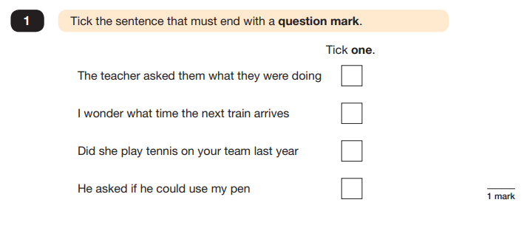
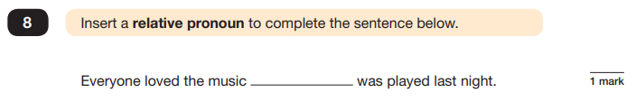
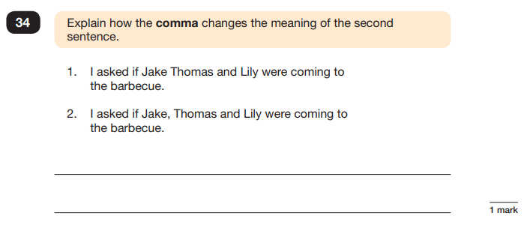
Spelling, Punctuation and Grammar: Paper 1
Example questions:
e.g. that, which
✓
e.g. The first sentence is about two people and the second sentence is about three people.
Notes:
For questions 8 and 34, there are various correct answers.

Slide 9
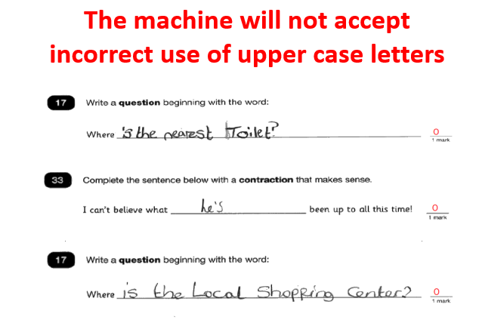
Incorrect use of capital letters will not be accepted

Slide 10
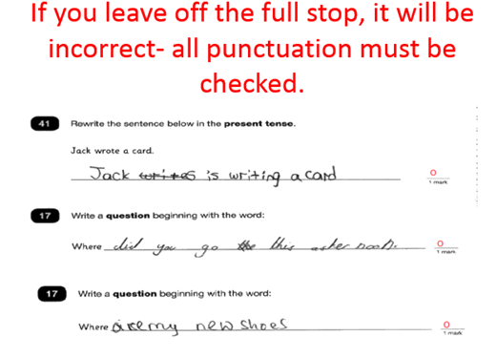
All punctuation must be checked.

Slide 11
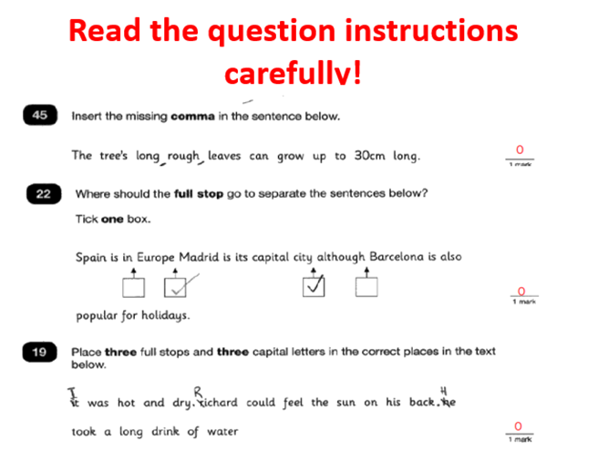
Questions must be read carefully.

Slide 12
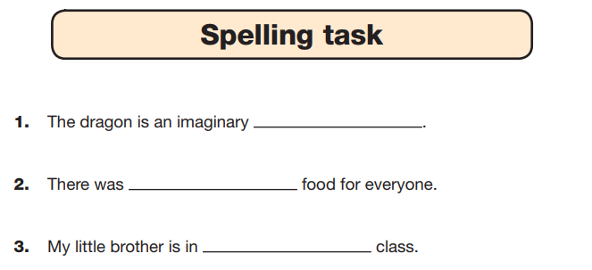
Spelling, Punctuation and Grammar: Paper 2
Paper 2 is a shorter paper that focuses solely on spellings.
Example questions:
Notes:
There is a spelling script that accompanies this. Example:
The word is creature. The dragon is an imaginary creature. The word is creature.

Slide 13
Reading: Tuesday 12th May
There is one reading test that lasts for 60 minutes.
The test is designed to measure if the children’s comprehension of age-appropriate reading material meets the national standard. There are three different set texts for children to read. These could be any combination of non-fiction, fiction and/ or poetry.
The test covers the following areas (known as Content Domains):
Give/ explain the meaning of words in context;
Retrieve and record information/ identify key details from fiction and non-fiction;
Summarise main ideas from more than one paragraph;
Make inferences from the text/ explain and justify inferences with evidence from the text;
Predict what might happen from details stated and implied;
Identify/ explain how information/ narrative content is related and contributes to meaning as a whole;
Identify/ explain how meaning is enhanced through choice of words and phrases;
Make comparisons within the text.

Slide 14
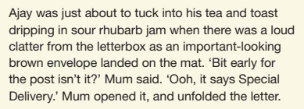
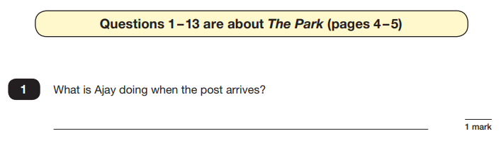
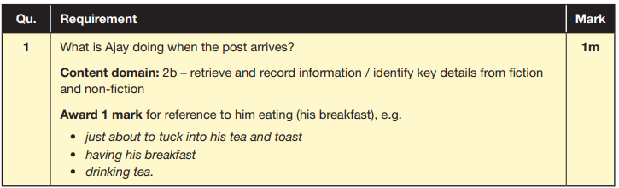
Reading
The reading SATs paper requires a range of answer styles.
Example questions:
Notes:
Question styles include:
Multiple choice questions
One-word answers
Short answer questions
Multiple mark (long answer) questions

Slide 15
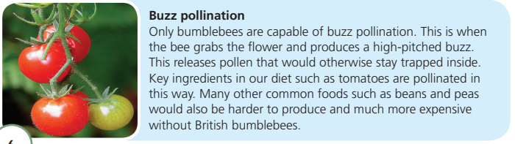
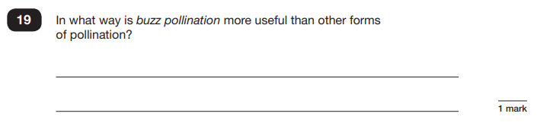
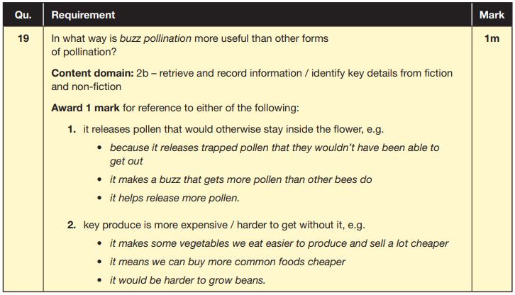
Reading
Example questions:
Based on text 2: Fact Sheet: About Bumblebees

Slide 16
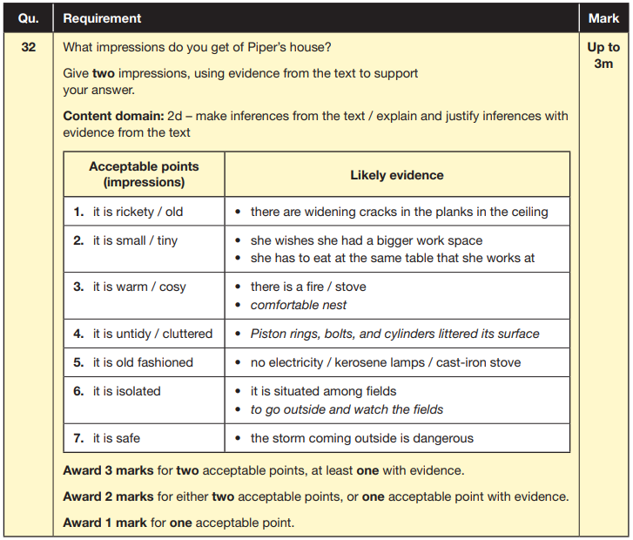
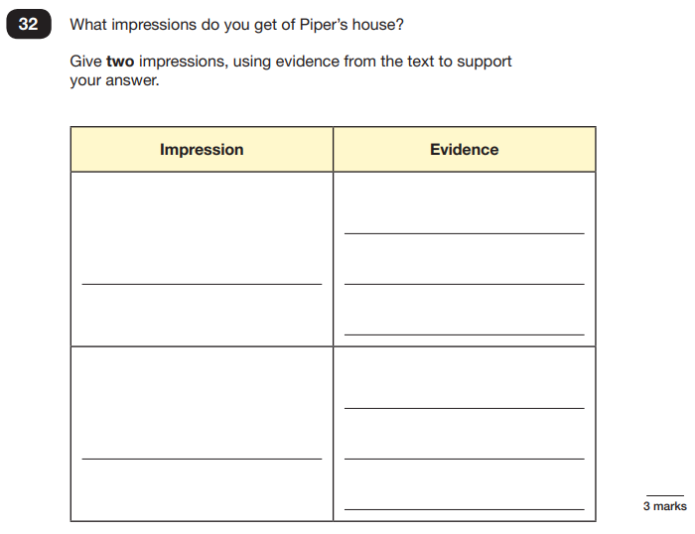
Reading
Example questions:
Based on text 3: Music Box
Notes:
This question is based on the whole text (2 pages).

Slide 17
Maths: Wednesday 13th May and Thursday 14th May
The maths assessments consist of three tests.
Paper 1: Arithmetic (30 minutes) – Wednesday 13th May
Paper 2: Reasoning (40 minutes) – Wednesday 13th May
Paper 3: Reasoning (40 minutes) – Thursday 14th May

Slide 18
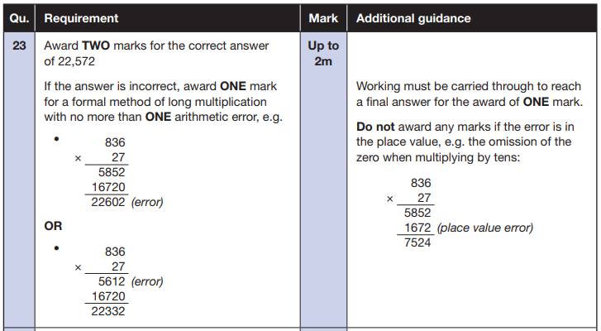
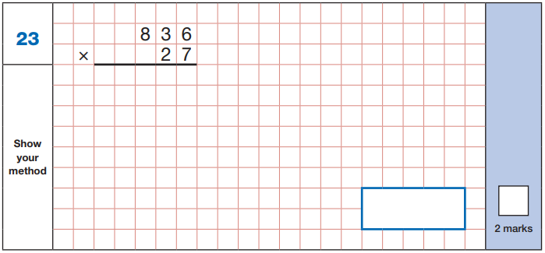
Maths Paper 1 (Arithmetic)
The maths arithmetic paper has a total of 40 marks.
The test covers the four operations (addition, subtraction, multiplication, division, including order of operations requiring BIDMAS), percentages of amounts and calculating with decimals and fractions.
Example question:
Notes:
Identify that there are some questions that have 2 marks and some that have 1. If the answer to this question is wrong, children could still get a mark for a correct method containing an error.

Slide 19
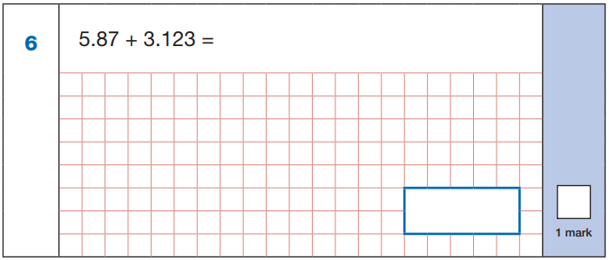
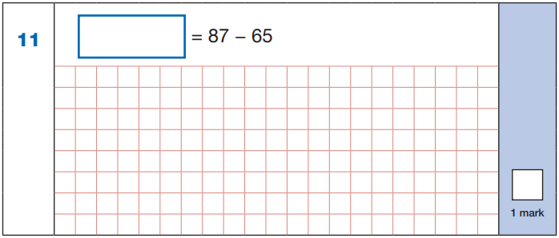

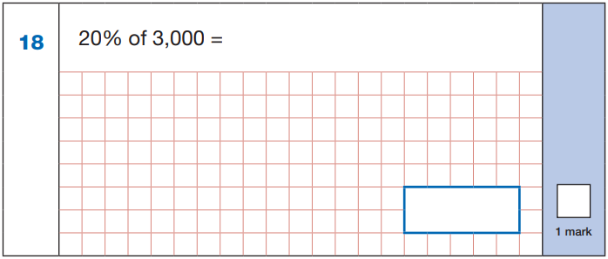
Maths Paper 1 (Arithmetic)
Example questions:
22
5.87
+ 3.123
8.993
87
- 65
22
8.993
60 ÷ (30 - 24)
60 ÷ 6 = 10
10% of 3,000 = 300
20% of 3,000 = 600
10
600
Notes:
These are examples of how children could solve the calculations. There are some that could/ should be solved mentally as it is far quicker that way (40 marks in 30 minutes does not allow for 1 minute + per mark).
Answers should always be given in their simplest form unless stated otherwise (e.g. for question 11, 20 + 2 would not be accepted as a correct answer).

Slide 20
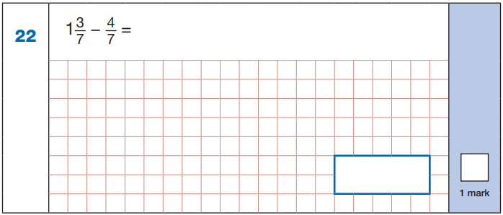
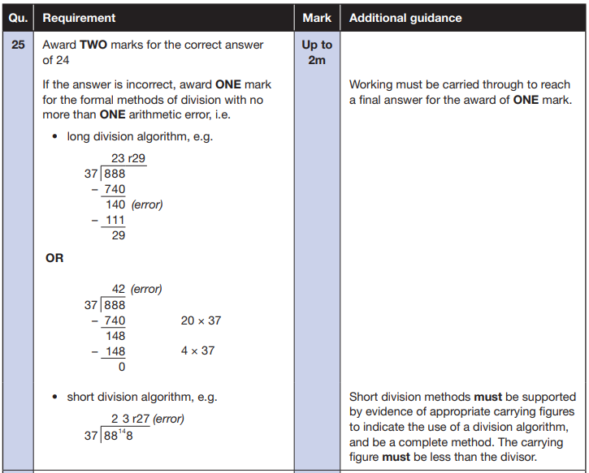
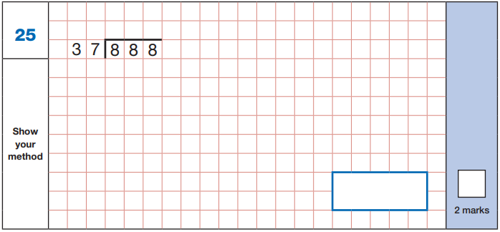


Maths Paper 1 (Arithmetic)
Example questions:
$\frac{\text{10}}{\text{7}}$ - $\frac{\text{4}}{\text{7}}$ = $\frac{\text{6}}{\text{7}}$
$\frac{\text{6}}{\text{7}}$

Slide 21
Maths Papers 2 and 3 (Reasoning)
Paper 2 will take place on Wednesday 13th May and paper 3 will take place on Thursday 14th May. These tests have a total of 35 marks each.
These papers require children to demonstrate their mathematical knowledge and skills, as well as their ability to solve problems and their mathematical reasoning. They cover a wide range of mathematical topics from key stage 2 including,
Number and place value (including Roman numerals);
The four operations;
Geometry (properties of shape, position and direction);
Statistics;
Measurement (length, perimeter, mass, volume, time, money);
Algebra;
Ratio and proportion;
Fractions, decimals and percentages.
Notes:
In general, the questions get progressively harder throughout the paper. As this is the case, it is not unusual for children to be unable to complete the entire paper in the given time. Maths Paper 1 (Arithmetic)

Slide 22
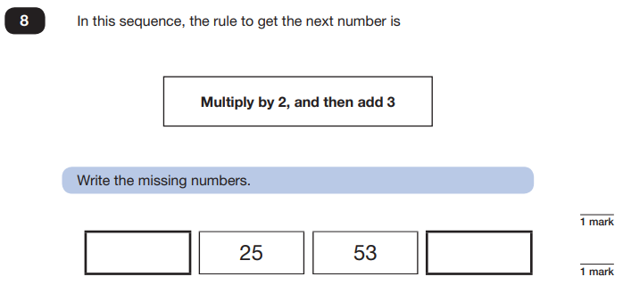
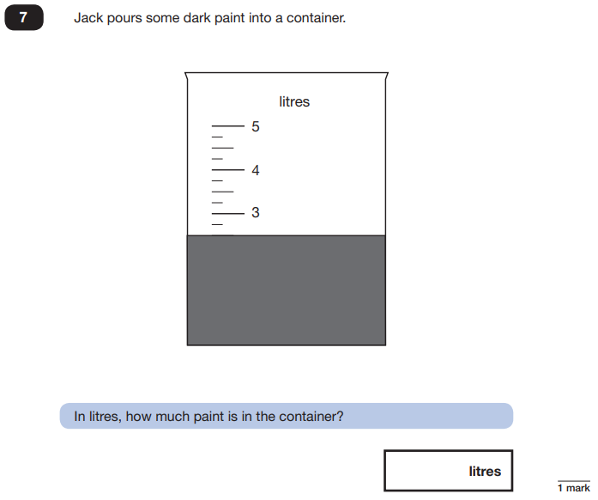
Maths Papers 2 (Reasoning)
Example questions:
11
109
2.5 or 2 ½

Slide 23
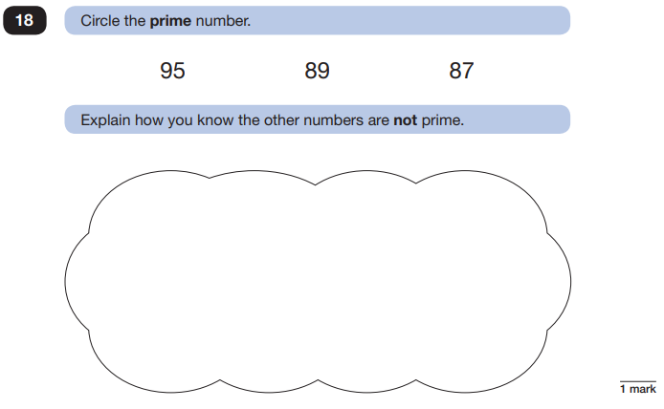
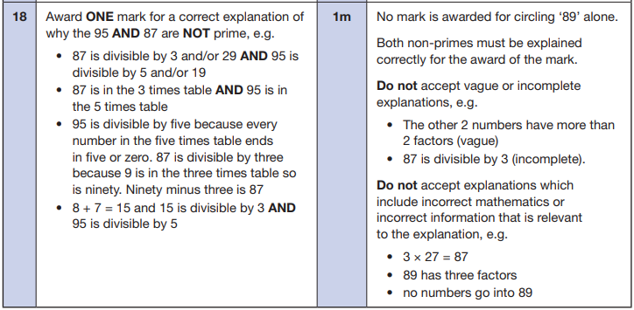
Maths Papers 2 (Reasoning)
Example question – opportunity for written answers
Notes:
This question is an example where pupils will need to justify their answer.

Slide 24
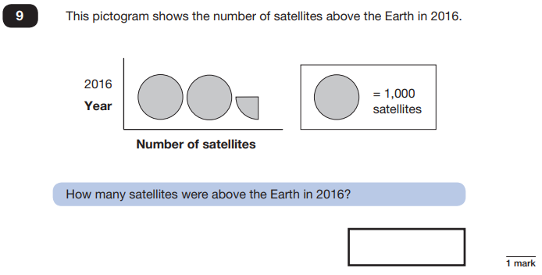
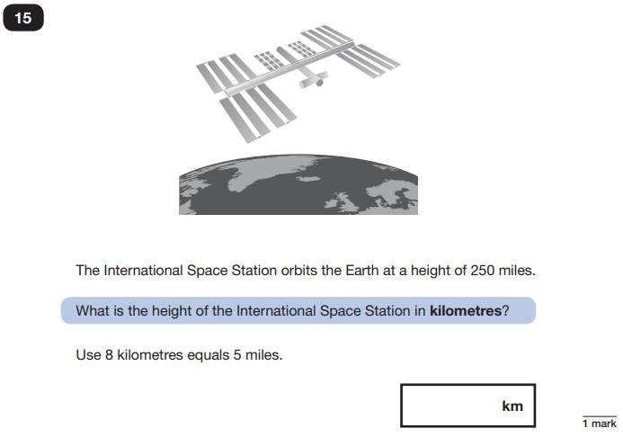
Maths Papers 3 (Reasoning)
Example questions:
2,250
400
Notes:
Question 9: Pictograms are part of the Year 3/ 4 curriculum.
Question 15: This show that children will need to know how to convert but they do not need to remember the conversion fact.

Slide 25
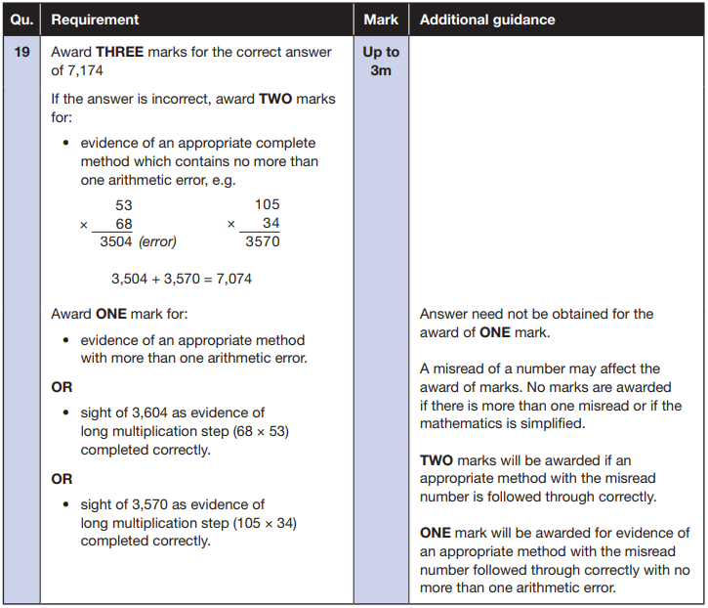
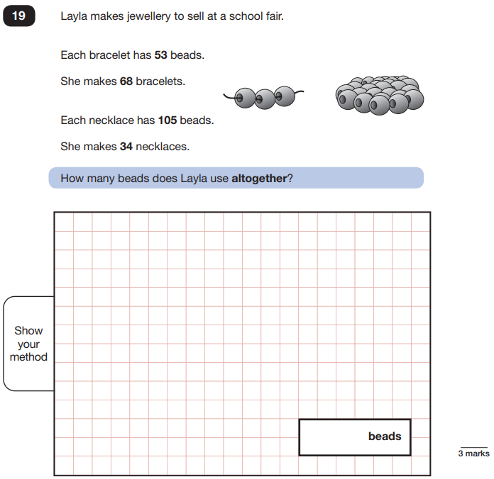
Maths Papers 3 (Reasoning)
Example question:
Notes:
Note that this is a three mark question.

Slide 26
Supporting your child in preparing for the SATs ☺
Firstly, a positive attitude goes a long way. Give them as much encouragement and support as you can (but we don’t need to tell you that)!
Tips:
Don’t use past papers as they are used in school to prepare the children.
Talk to with Miss Marvin or Miss Dyer if you have any concerns.
Encourage your child to talk to us or a trusted adult (including yourself) about their anxieties. Don’t forget that a small amount of anxiety is normal and not harmful.
Give your child a quiet, distraction free space to complete homework. This is invaluable in the lead up to SATs.
Give your child time to go outside and reduce screen time.
Ensure your child is eating and drinking well and getting a good amount of sleep.
Plan something nice and fun for the weekends before and after SATs. This will help them to relax before the SATs and give them something to look forward to after.
Notes:
Encourage parents not to use past papers at home. If they want to use past papers with tutors, suggest that they could take copies of completed test home to work through with tutors. This may help them to work through specific misunderstandings.

Slide 27
Things to remember about SATs
SATs focus on what children know about Maths and English.
They will not reflect how talented they are at science, geography, art, PE…, and they certainly won’t highlight all of their amazing personal characteristics!
SATs don’t tell the whole story.
Their results will say if they did or did not meet a certain standard but not necessarily by what margin. These thresholds change each year according to the overall national performance, so what was classed as ‘meeting the expected standard’ this year might not be the same as last year.
SATs are only four days out of a whole Primary School career!
In reality, there’s one or two papers each day that last 30 to 60 minutes.

Slide 28
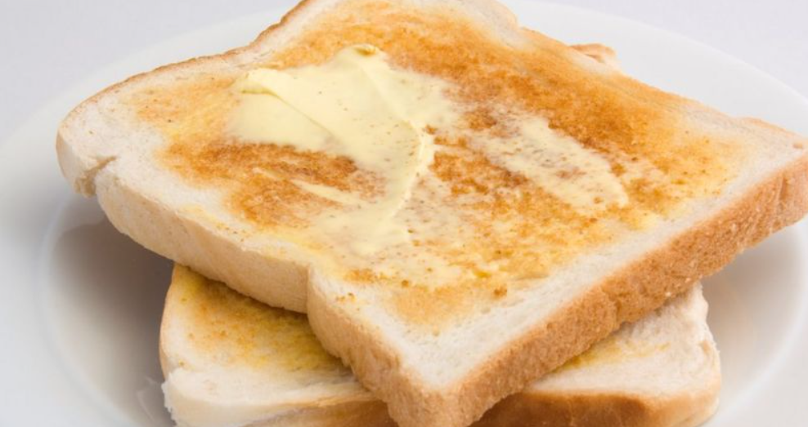

SATs Breakfast Club (Monday - Thursday)
* A relaxing start to the day.
* A boost to concentration levels.
* All children encouraged to attend.
* 8:30 start (TBC).
* Toast/pastries/fruit and juice offered.
Notes:
28

