Slide 1

Welcome to Year 6!
“Learning for Life” to
“Paint Your Own Rainbow ”
September 2025

Slide 2

Meet the Team
Class Teacher Violet 1 – Miss Marvin
Class Teacher Violet 2 – Miss Dyer
Teaching Assistant: Mrs Pailing and Mr Smith

Slide 3
Curriculum Overview
Core subjects continue to be covered throughout each week – English, maths and science.
PE will continue to take place twice weekly.
All other subjects will be covered in topics across the year, to allow for keys skills and knowledge to be revisited.
Parent events to celebrate learning will take place across the year.
Each year group will have class visitors and class visits throughout the year.
To enable forward planning for parent contributions, information will be shared during the autumn term for the whole academic year, for visits and visitors where a financial contribution will be requested.

Slide 4
Year 6 Curriculum
Autumn Term
English: We will use several books as a focus for our English lessons. These will support the children in writing in a variety of genres with a wide subject focus. For Autumn 1 the books are: ‘The Last Bear’, ‘Darwin’s Voyage of Adventure’, ‘Tiger Rising’ and ‘Windrush Child’
Maths will focus on place value, number operations, fractions and converting units of measurement.
In Science we are looking at ‘Animals and their Habitats’ and then moving on to ‘Evolution and Inheritance.’
PSHE will look at successful teamwork and digital wellbeing and in RE we look at Sikh, Muslim, and Christian values and traditions.
In Geography, we will learn about the major deserts in the world and where they are located. We look at physical and human differences between developing and developed nations.

Slide 5
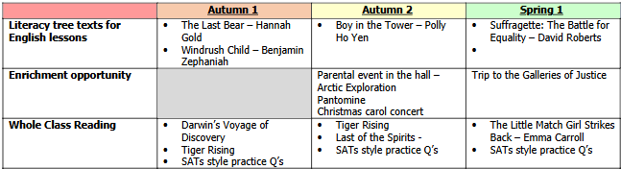
Key Dates

Slide 6
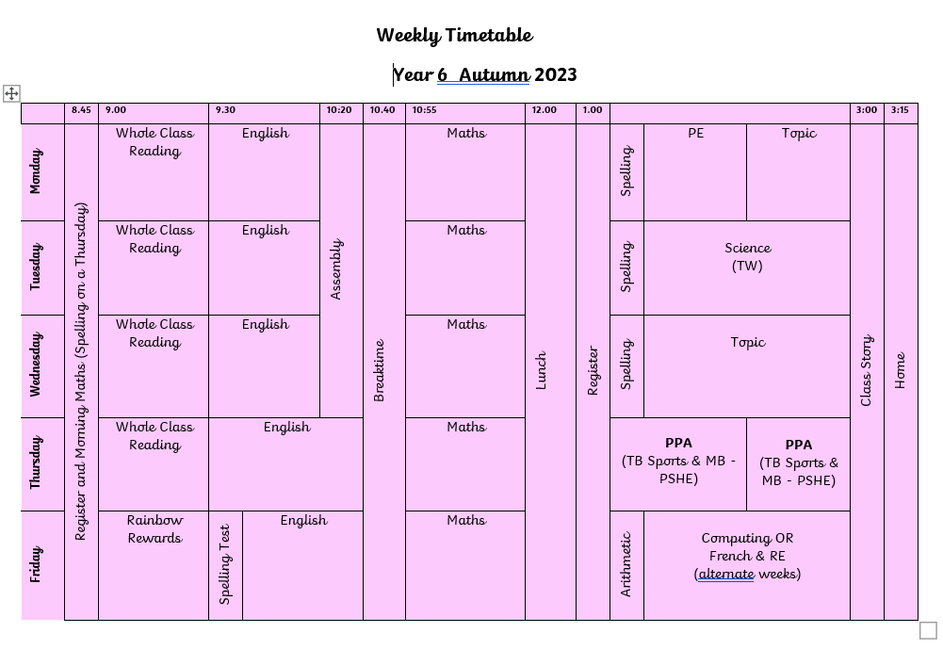
Timetable
Start of the day: doors open from 8:45, register at 8:50, doors close at 8:55
End of the Day: 3:15pm

Slide 7

Rainbow Rewards
Children will be nominated to receive a Rainbow Reward assembly certificate.
Rainbow Rewards Certificates will be presented by Mrs Bates each week on a Friday.
Your child will bring home their certificate and it will also be displayed in school.
Parents will be invited to the Rainbow Reward assembly. They will know if their child has been given the award the week before the assembly.
R - respect and acceptance A - active body and active mind I - inclusive yet individual N - nurture, develop and grow B - believe in yourself O - overcome your obstacles W - wonder and curiosity
“Learning for Life” to
“Paint Your Own Rainbow ”

Slide 8
Homework
In year 6 homework will be sent home weekly.
The children will each have a homework book to stick in their sheets and complete the homework.
The work will focus on learning that has taken place in class and should act as a consolidation of the class learning.
The children will have a week to complete their homework. It will be sent home on Friday, and we will mark it in school the following Friday.
There will also be weekly spellings which will be given on Friday and will be tested the following Friday.
Children should read at least 3 times a week. This can be recorded in their diary.
Maths skills non-negotiables can be seen on the next slide. These can also be recorded if you wish to in the diary.

Slide 9
Maths Non –Negotiables Year 6
Know all previous number bonds including decimals
Know and use all multiplication and division facts for the times tables up to 10x
To multiply and divide whole numbers and decimals by 10,100 and 1,000
Recall and use simple equivalences between simple fractions, decimals and percentages including in different contexts

Slide 10

Reading Books
Each child will bring home a reading book tailored to their current reading attainment.
All children are encouraged to enjoy a wide range of texts in school and at home, beyond the levelled reader allocated.
All children will also visit the school library weekly and are able to borrow a book of their choosing to enjoy at school and home.

Slide 11
Break Time Snacks
Children are encouraged to make healthy choices
Tuck shop items can be ordered and paid for through ParentMail. Please ensure that you have ordered in advance.
Children may bring their own healthy breakfast bar or fruit/vegetable snack to eat at morning break. These should not be crisps or contain any chocolate (and ideally be low in refined sugar too).
Milk for morning break can be ordered directly and prepaid for via the Cool Milk link https://customers.coolmilk.com/v2/register/
Water Bottles
Each child should have their own named water bottle. We do not have cup for water in the classrooms.
Water bottles are to be brought into school each morning and taken home daily (for hygiene purposes)
Water bottles should contain water only, no juice or fizzy drinks please.

Slide 12
In Year 6…
P.E Kit – To be worn to school for the whole day on Monday and Thursday each week
Home school diary needs to be in school daily
  – please tell your child if you have written a note for school
Keep an eye on our website for Head Teacher blogs and half-termly class updates
WEDUC is used to send whole class and 1:1 messages during the hours of 08:30 and 17:30
For urgent messages (needing response or action within 24 hours) contact school office
Please ensure that all personal belongings are clearly labelled with your child’s name
All stationery is provided so no pencil cases are needed

Slide 13
Also in Year 6 …
Year 6 SATs
Do not worry!
Monday 11th May- ~Thursday 14th May 2026
Children will have practise throughout the year
Ways to help…
Make sure the children are at school and on time
Encourage completion of weekly homework

Slide 14
Any Questions?
Please do contact the class teacher directly via Weduc
Or contact the school office on office@Greasley.notts.sch.uk or 01773 712128

