Slide 1







Thinking Moves

Slide 2

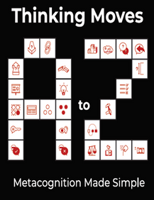


What is a thinking move?
Roger Suttcliffe developed a simple and memorable scheme called Thinking Moves, A-Z. (https://www.thinking-moves.com/)
These have been designed so that teachers can teach the skill of thinking more effectively. At Greasley, we do not just simply ask our children to ‘have a think about a problem or question,’ we explicitly direct the children to the thinking skill we want them to use.
Each move comes with a move which is taken from the British Sign Language.
This helps our children to remember the move and the Thinking Skill.

Slide 3
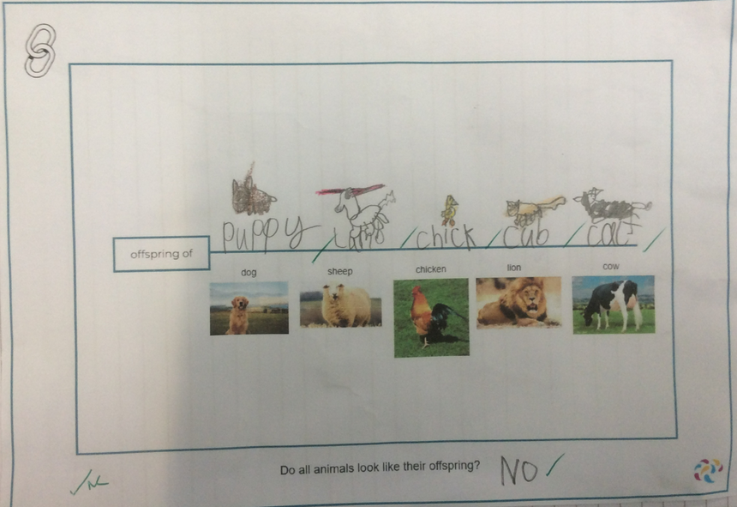
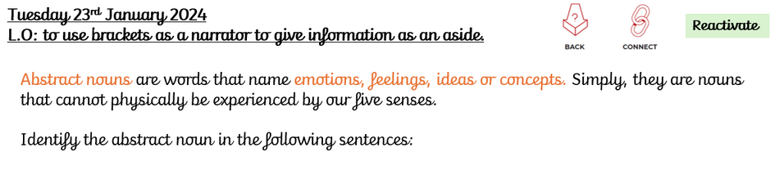
Where will you see them used?
The Thinking Moves link to our Thinking Frames. You will see them on our Thinking Frames, on the teaching slides in lessons and when the children are using a thinking skill.

Slide 4

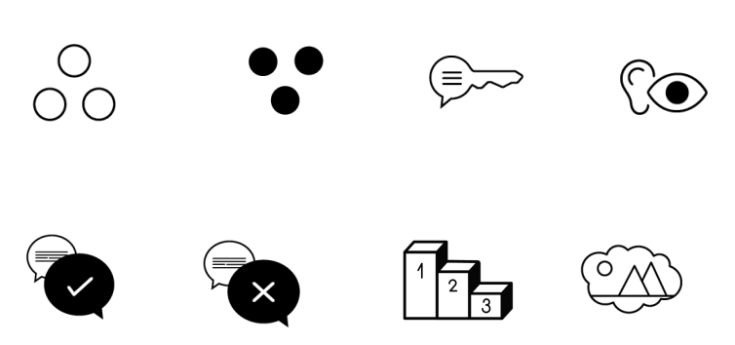
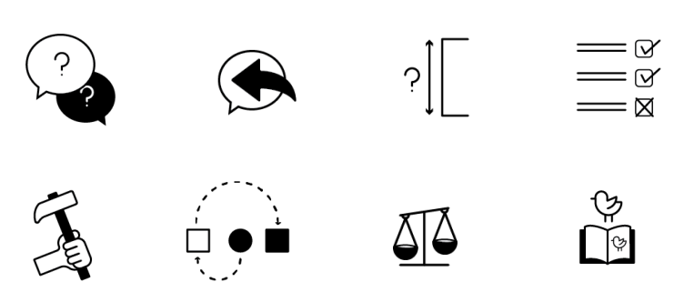


Thinking moves
Ask your children to show you the moves that match the icon. We know them all!

Slide 5


Scan the QR code to watch the children at Greasley Beauvale Primary School perform the Thinking Moves A-Z.

