Slide 1




The Science of LEarning

Slide 2
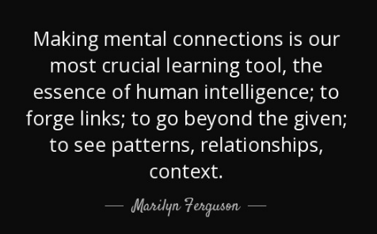

Slide 3

Making connections
The ability to make connections involves a process of connecting prior knowledge to new knowledge and experiences. This process allows students to relate what they read, see, do, and experience to themselves, to the world around them and/or to other things they have read, seen, or experienced previously.

Slide 4
Making Connections is important because it..…
  enables students to build on their prior experiences to further construct knowledge and make meaning of the world around them
  provides opportunities for the development of deeper understanding of concepts, skills and the nature of science and technology

Slide 5
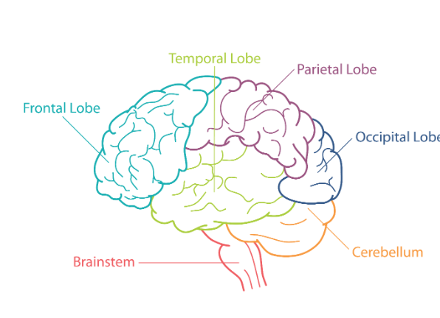
The brain
The frontal lobe is the largest of the lobes and the most complex part of the brain. It controls executive functions, a set of cognitive processes that are necessary to manage behaviour and meet goals. The frontal lobe also plays a role in reasoning, decision-making, planning, and emotion regulation.
The temporal lobe is responsible for processing and interpreting sound (including language) and plays a role in forming and retrieving memories.
The cerebrum is covered by a layer of tissue called the cerebral cortex, which is the outermost layer of the brain and where most of the actual information processing in the brain takes place.

Slide 6
the science behind making those connections...
We need to join the building blocks in the brain (the neurons) together. They join together when the dendrites meet.

Slide 7
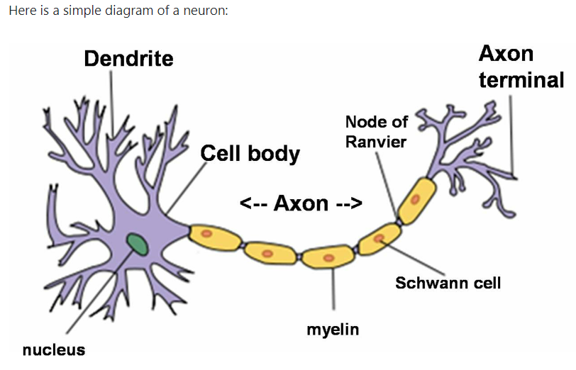
What is a neuron?
When we learn something new we make a connection to previous learning. The more times we re-learn, repeat or revisit this learning, the more memorable (sticky) the knowledge becomes. Think about learning a dance routine. The more times you rehearse, the more it sticks and you know the moves.

Slide 8
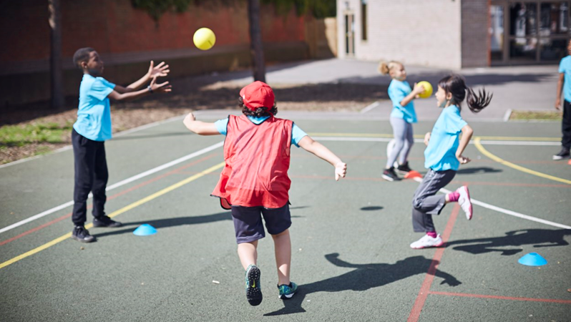
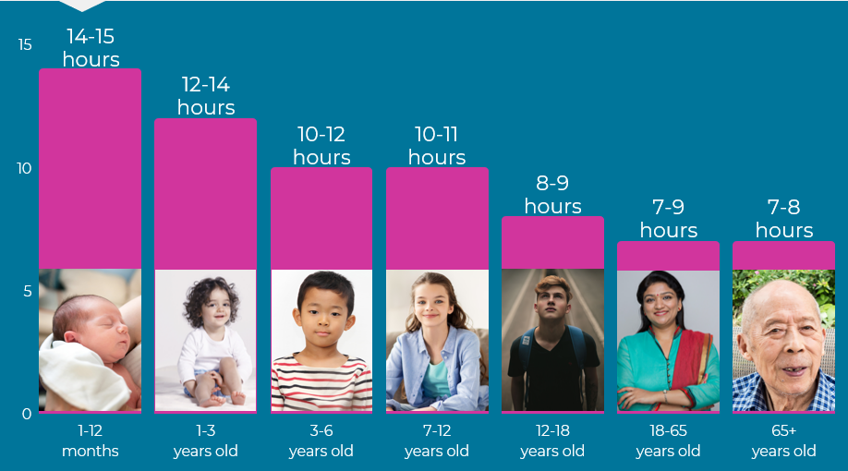
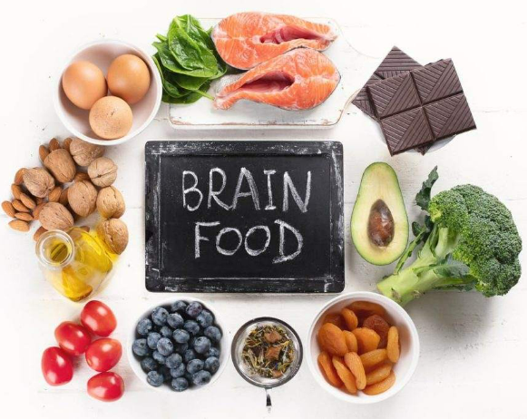
How can we keep the brain healhty?

Slide 9

Cognitive overload

Slide 10
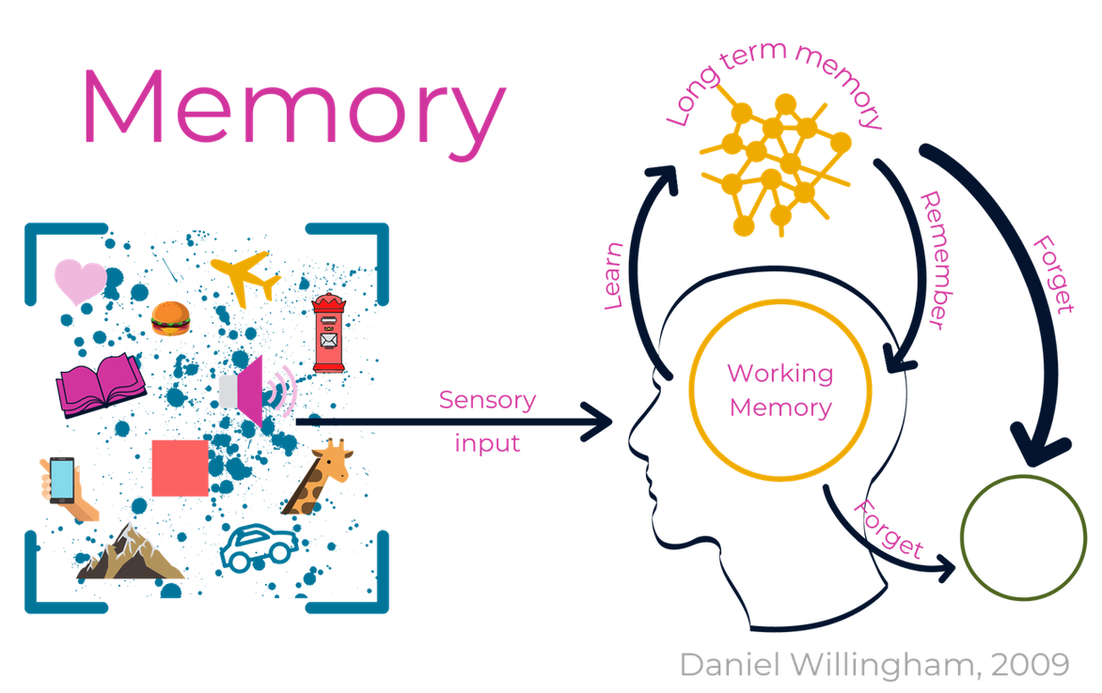
Our brains can only hold and take in so much information before they become full
(cognitive overload)
This may come from the environment (noise, smell, sound) as well as what we are trying to learn.

Slide 11
How can we help learning stick?
  Learn in chunks (break the learning into manageable parts)
  Complete mini quizzes to test your new knowledge
  Teach your new knowledge to someone else
  Use visual aids, pictures, labelled diagrams
  Make up a story or a song
  Avoid cognitive overload by focusing on a maximum of 4 things at a time

